Slide 1

Part IV Case studies
Fausto Carcassi

Slide 2
Intro & structure
We have seen how pLoT models work
This has been applied to many domains in the literature
Four examples today:
Kinship
Numerals
Visual concepts
Binary sequences
Part I | Introduction: On the very idea of an LoT
Part II | Technical background
Part III | Bayesian program induction (LOTlib3)
Part IV | Case studies
Part V | Summary & Future prospects

Slide 3
Kinship - Mollica & Piantadosi (2021)

Slide 4
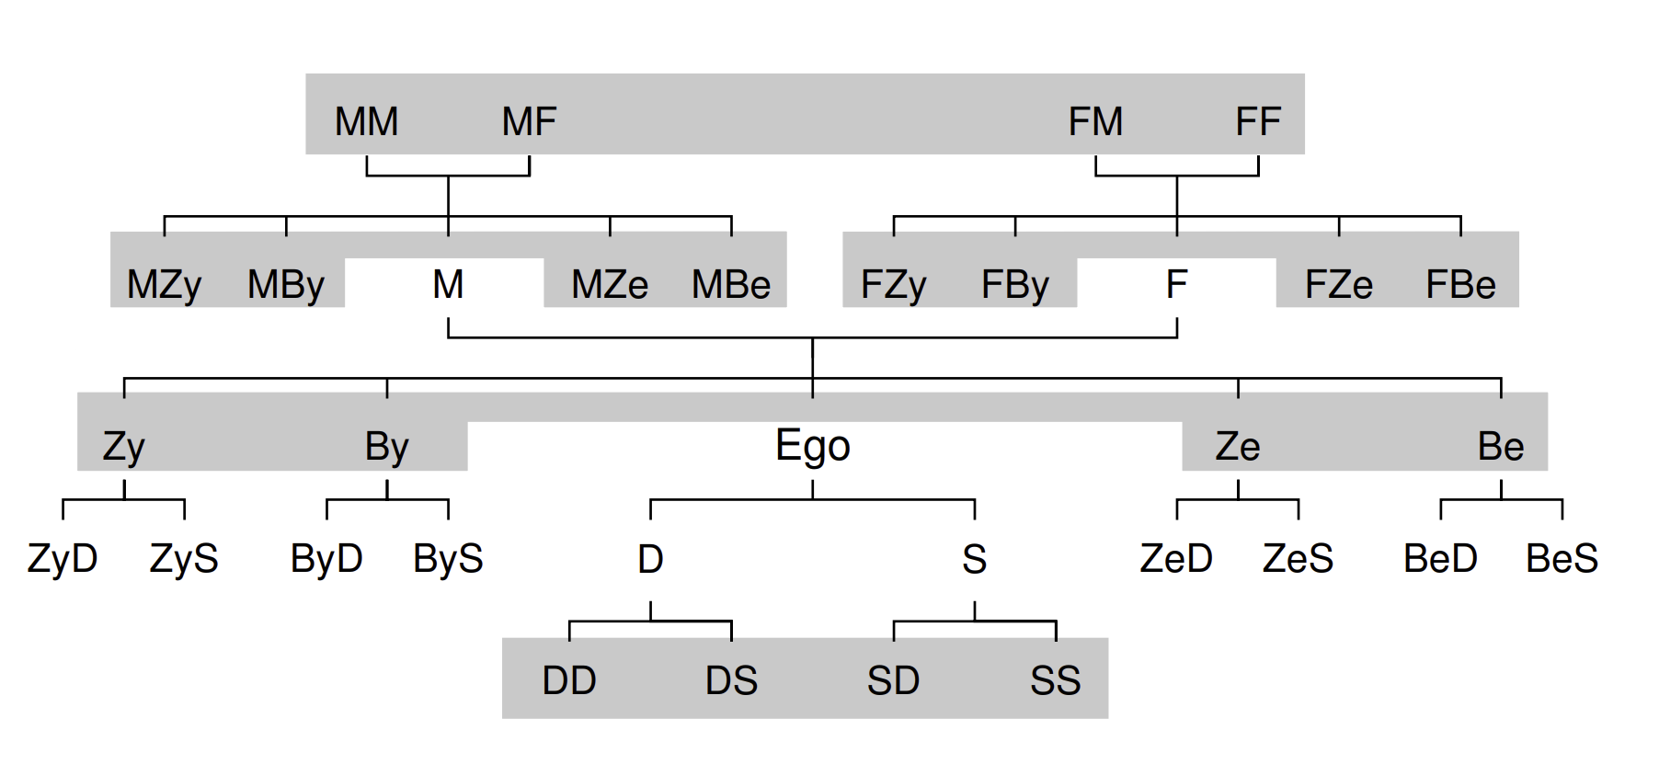
Kinships terms
Mollica & Piantadosi (2021), Logical word learning: The case of kinship.
Kinship terms express relative positioning in a family
Rich logical structure: they express complex relations.
Kemp & Regier (2012)

Slide 5
Kinships terms – Data
A single datapoint is a collection of four objects:
Speaker who uses the kinship word
Word used by the speaker
Referent identified by the word
Context consists of a family tree
The child sees datapoints & infers the meaning of kinship terms!

Slide 6
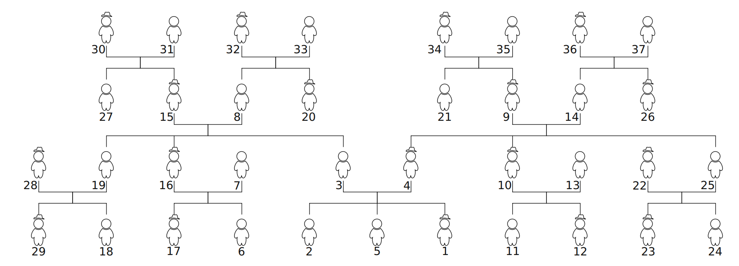
Kinships terms – Hypothesis space
Hypothesis: set of people in a family from the point of view of the speaker.
37 possible people
Numbered by rank of number of interactions with the learner:
Learner

Slide 7
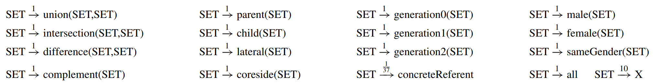
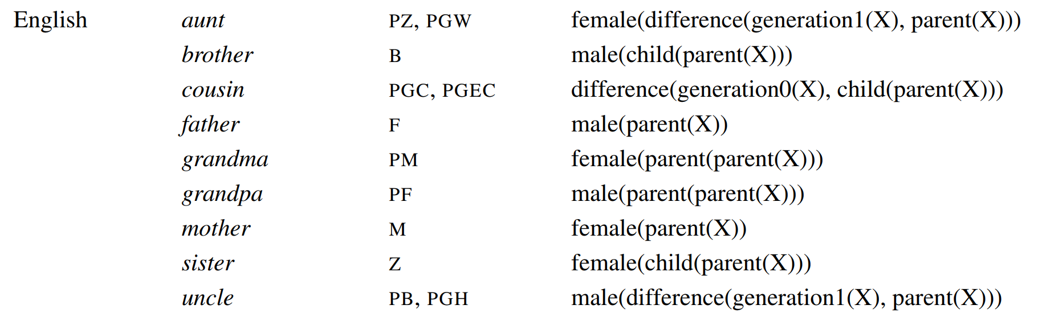
PCFG & induced prior
The PCFG contains the following primitives:
E.g.,

Slide 8
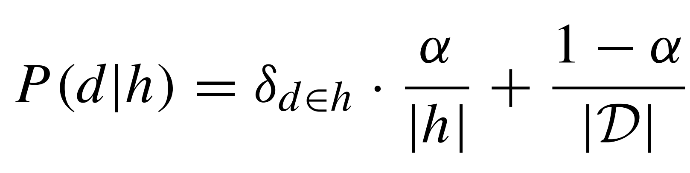
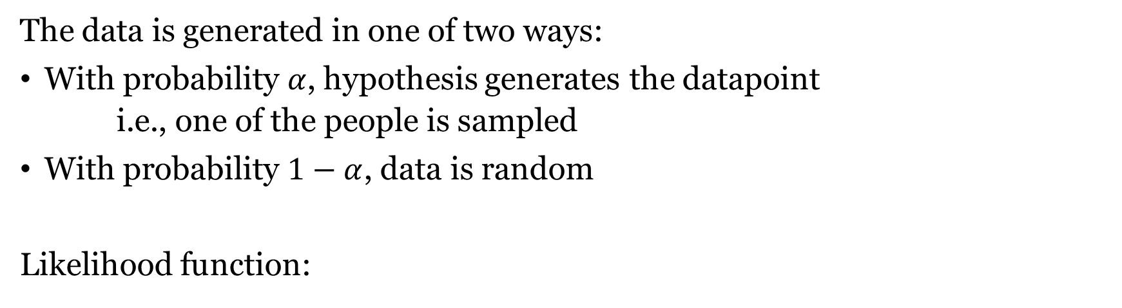
Likelihood function
The data is generated in one of two ways:
With probability $α$, hypothesis generates the datapoint
i.e., one of the people is sampled
With probability $1−α$, data is random
Likelihood function:
Whether d belongs to h
Size of h
Size of domain

Slide 9
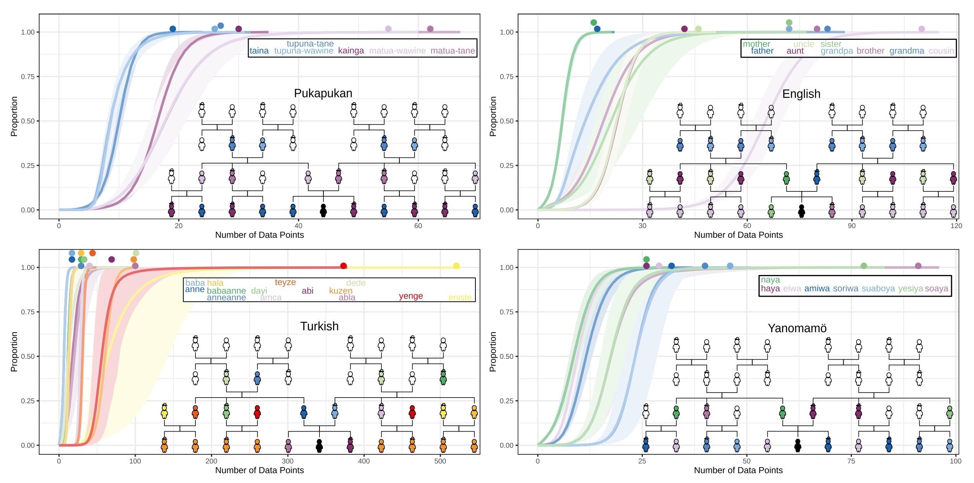
Results – prob of acquiring true meaning

Slide 10
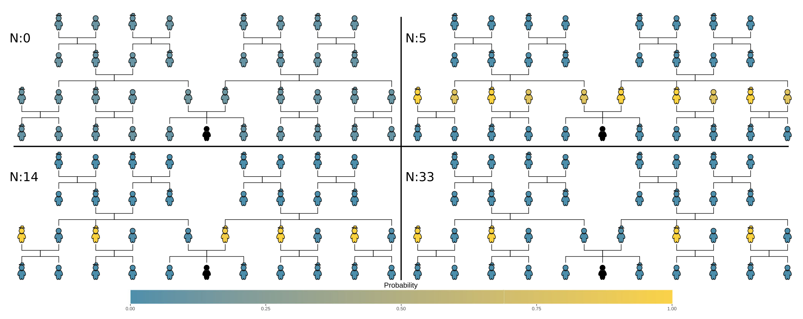
Results - overextension
Children learn a larger category than the true ones. “Uncle”:

Slide 11
Results
For few datapoints, preference for concrete reference (single individuals) over classes of individuals.
This is consistent with what children do!
Characteristic-to-defining shift
Young children over-extend with characteristic features (“robbers are mean”) vs defining features (“robbers steal things”).

Slide 12
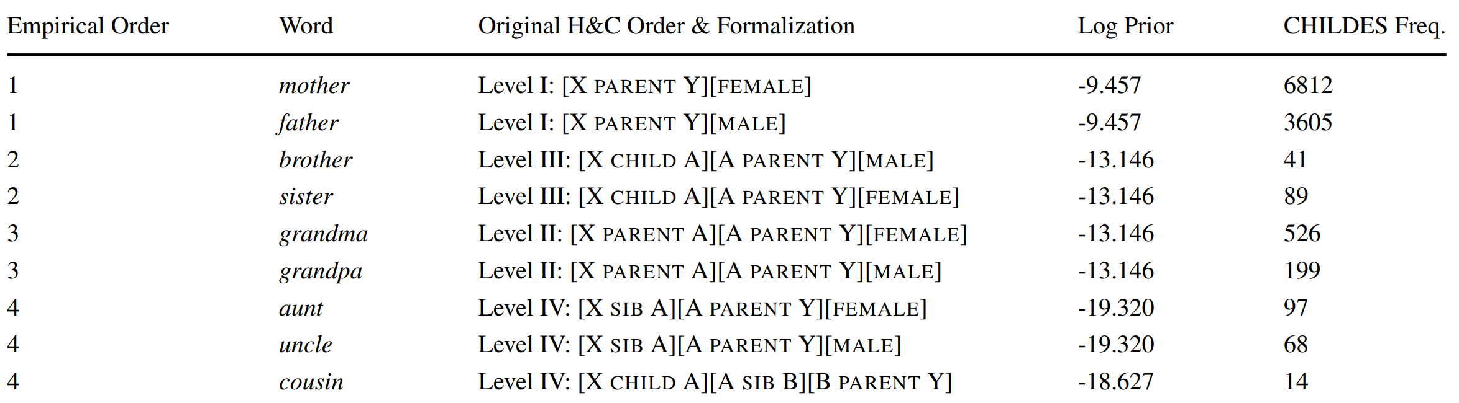
Results
Order of acquisition does not align with CHILDES frequency:

Slide 13
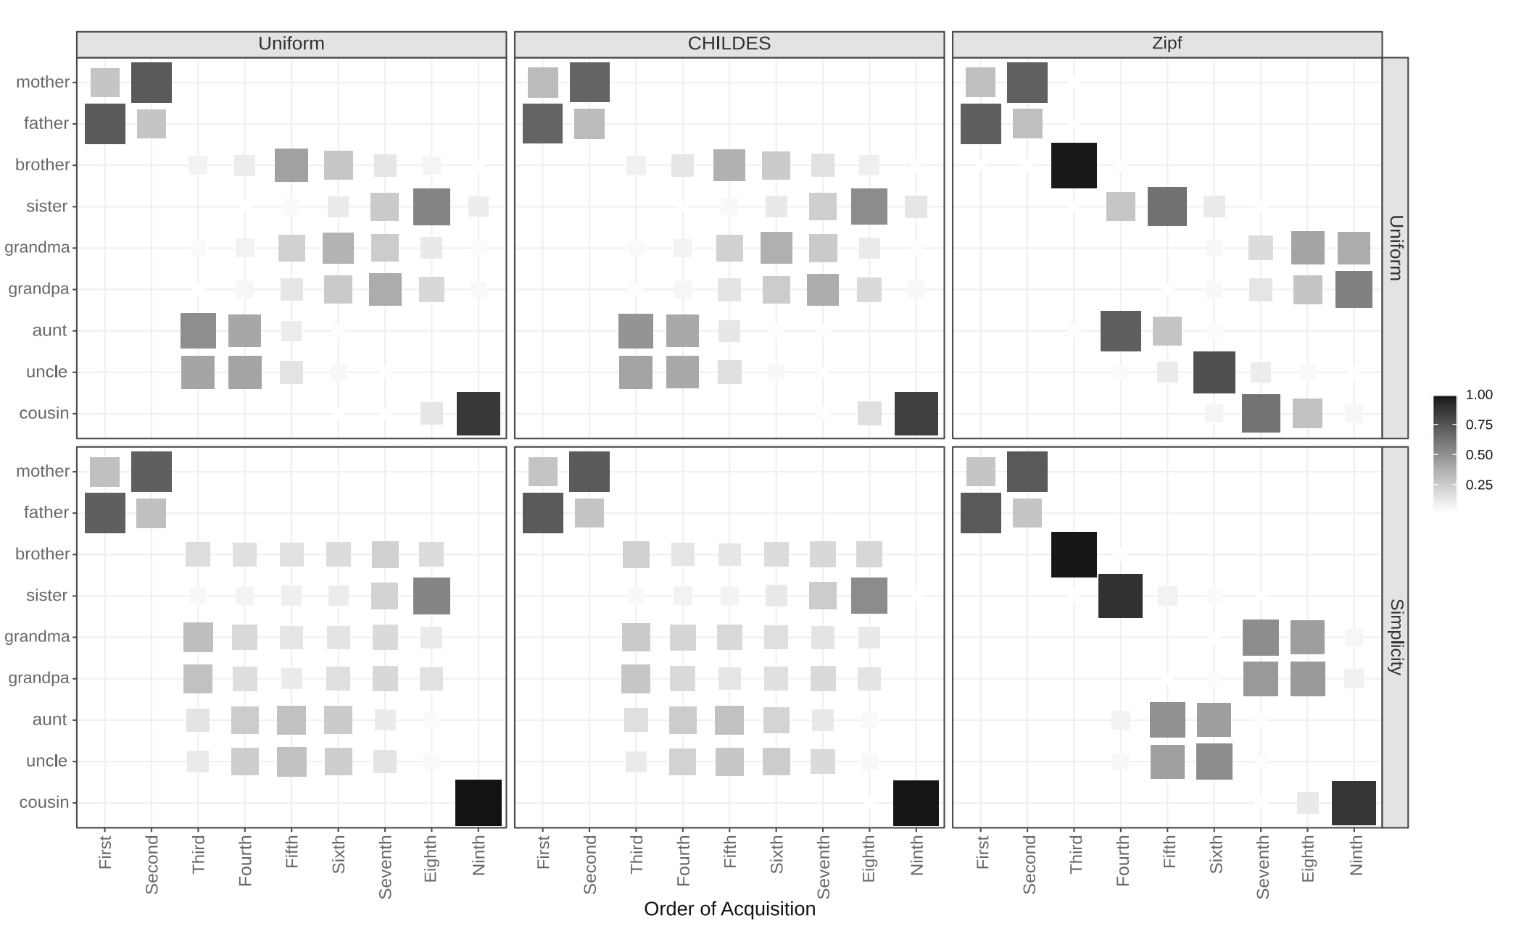
Results
Much more in paper (e.g., experimental results) but we do not have time!

Slide 14
Numbers - Piantadosi et al (2012)

Slide 15
Learning Numerals with an LoT
Piantadosi et al (2012), Bootstrapping in a language of thought: A formal model of numerical concept learning.
Regular patterns in number systems acquisition.
The first learn to recognize small sets of size 1, then 2, then 3, etc.
At about 3;6 they learn the full recursive system
Cardinal Principal learners
Qualitative jump rather than smooth progress!
Can pLoT reproduce qualitative conceptual jumps?

Slide 16
Learning Numerals with an LoT
Three choices for functions encoding meaning of number words:
Number word to a predicate on sets n –> “Are there n?”
Set to a number word S –> “How many are there?”
Objects in the situation to set n –> “Construct n”
Children can do all these three things; no clear empirical evidence.
They go the second way: from a set to a number word.

Slide 17
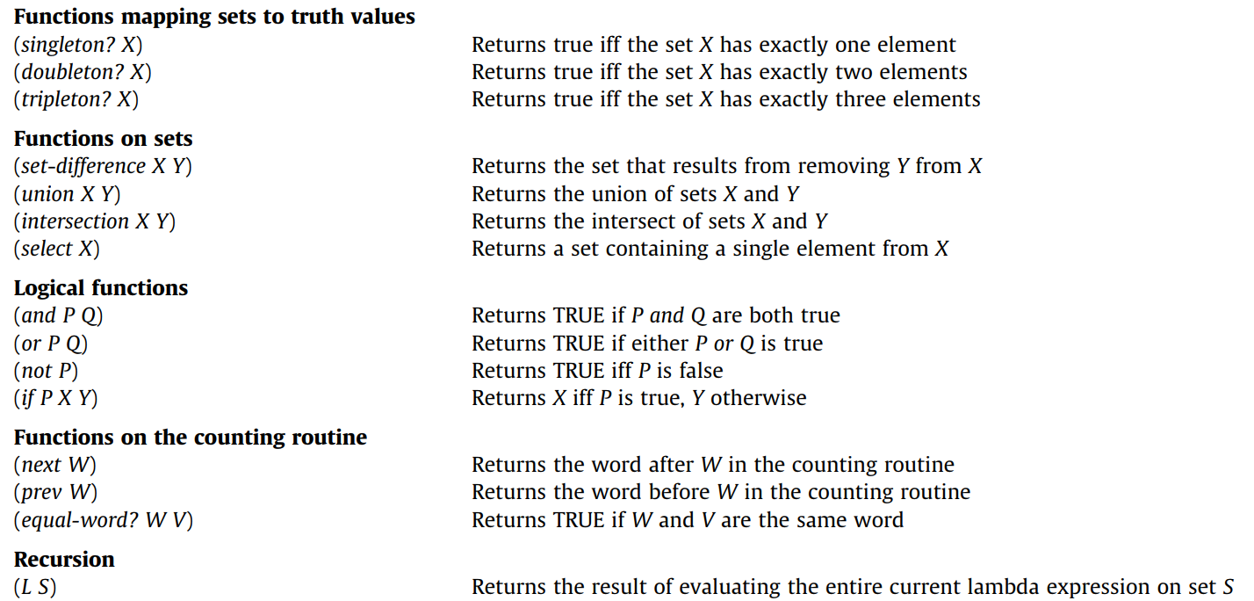
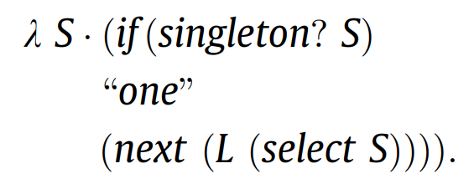
Learning Numerals with an LoT

Slide 18
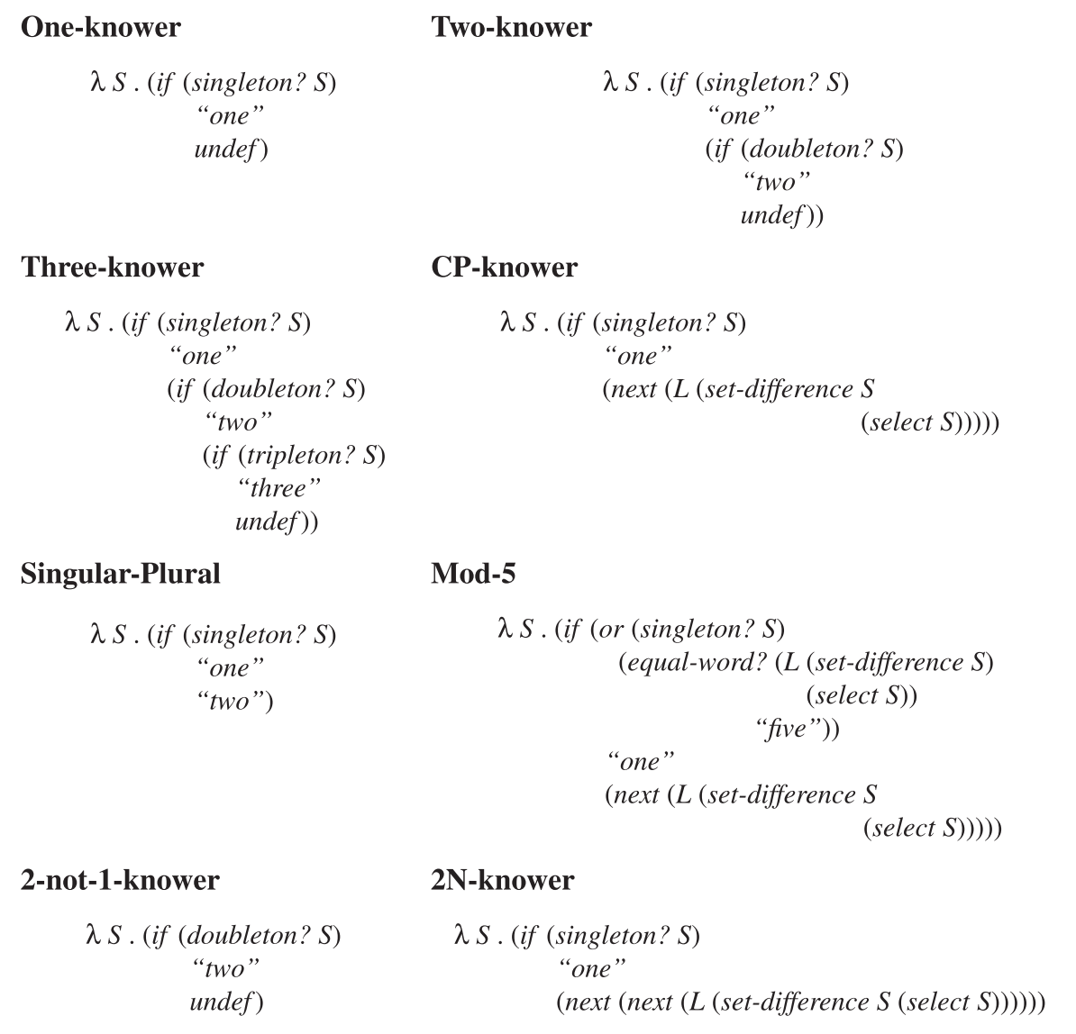
Learning Numerals with an LoT

Slide 19
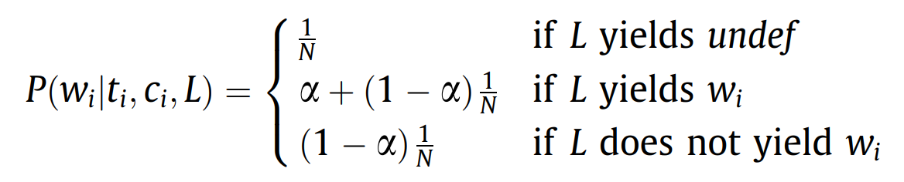
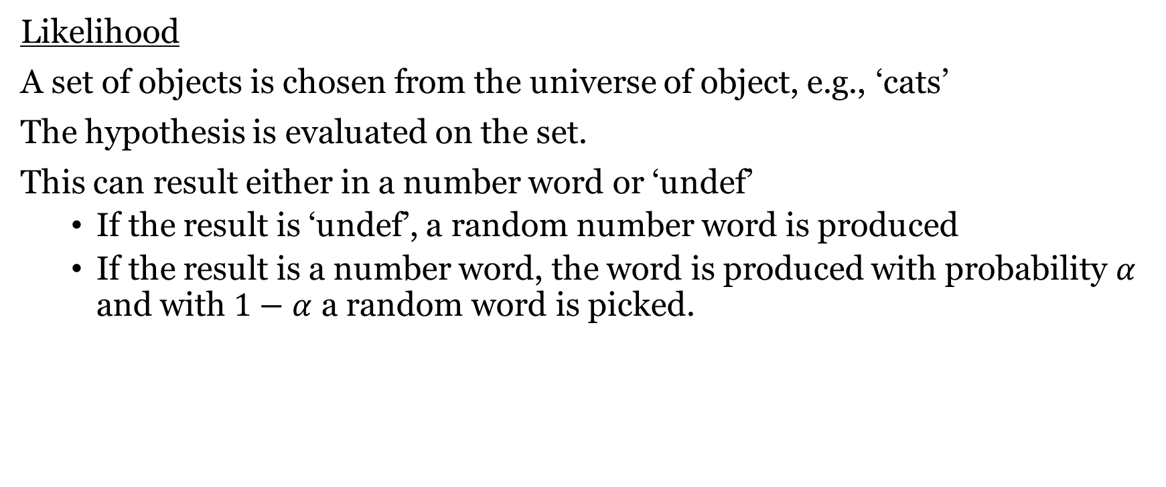
Learning Numerals with an LoT
Likelihood
A set of objects is chosen from the universe of object, e.g., ‘cats’
The hypothesis is evaluated on the set.
This can result either in a number word or ‘undef’
If the result is ‘undef’, a random number word is produced
If the result is a number word, the word is produced with probability $α$ and with $1−α$ a random word is picked.

Slide 20
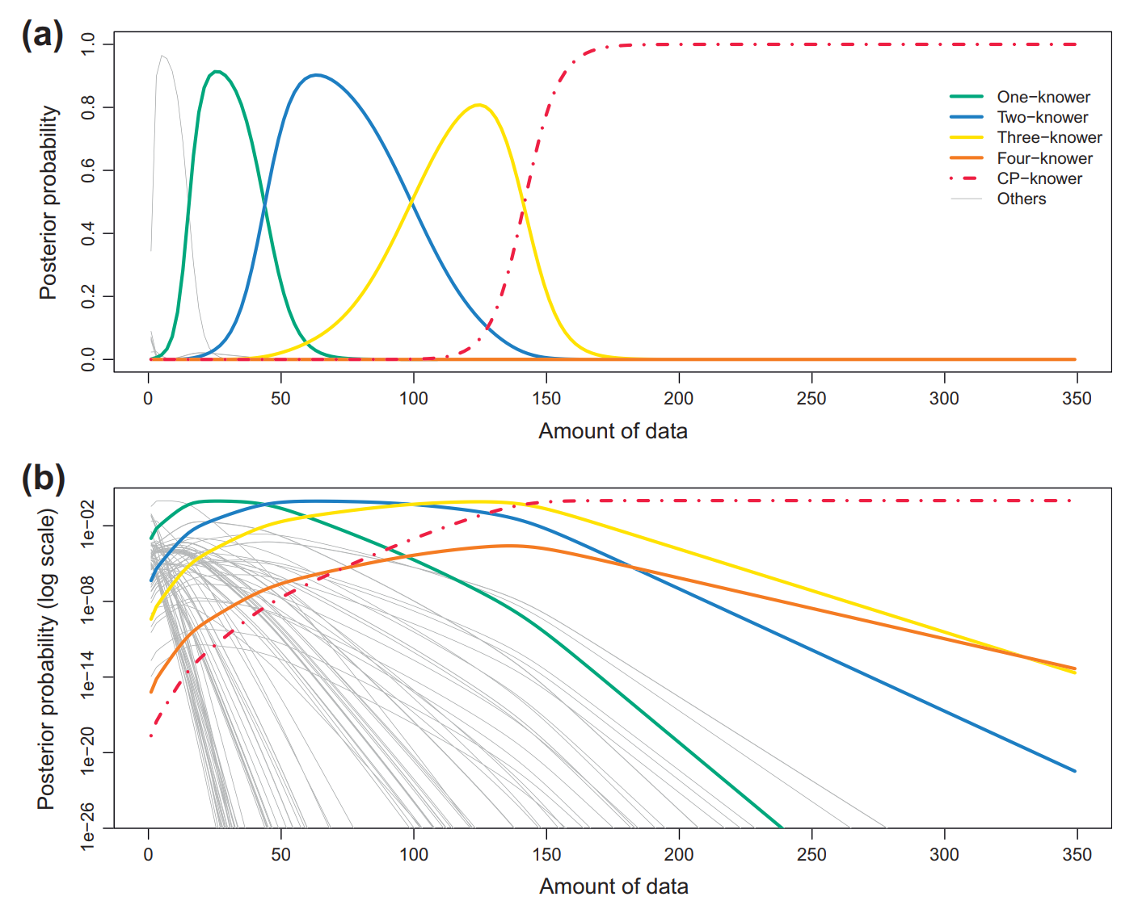
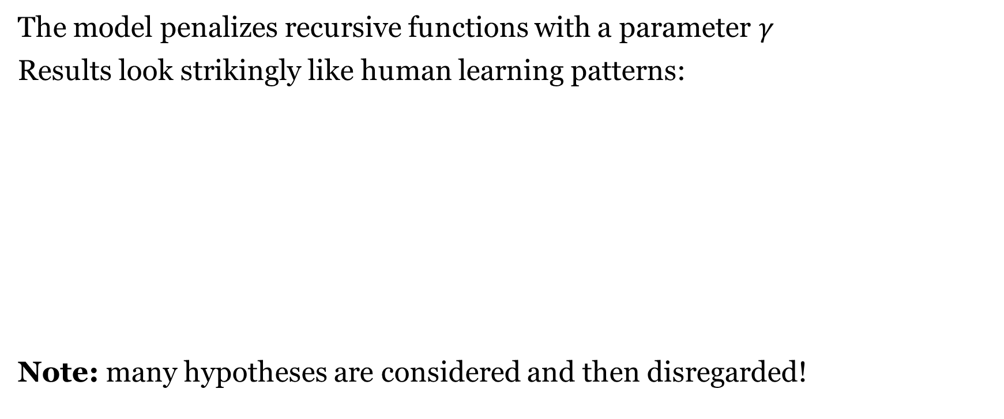
Learning Numerals with an LoT
The model penalizes recursive functions with a parameter $γ$
Results look strikingly like human learning patterns:
Note: many hypotheses are considered and then disregarded!

Slide 21
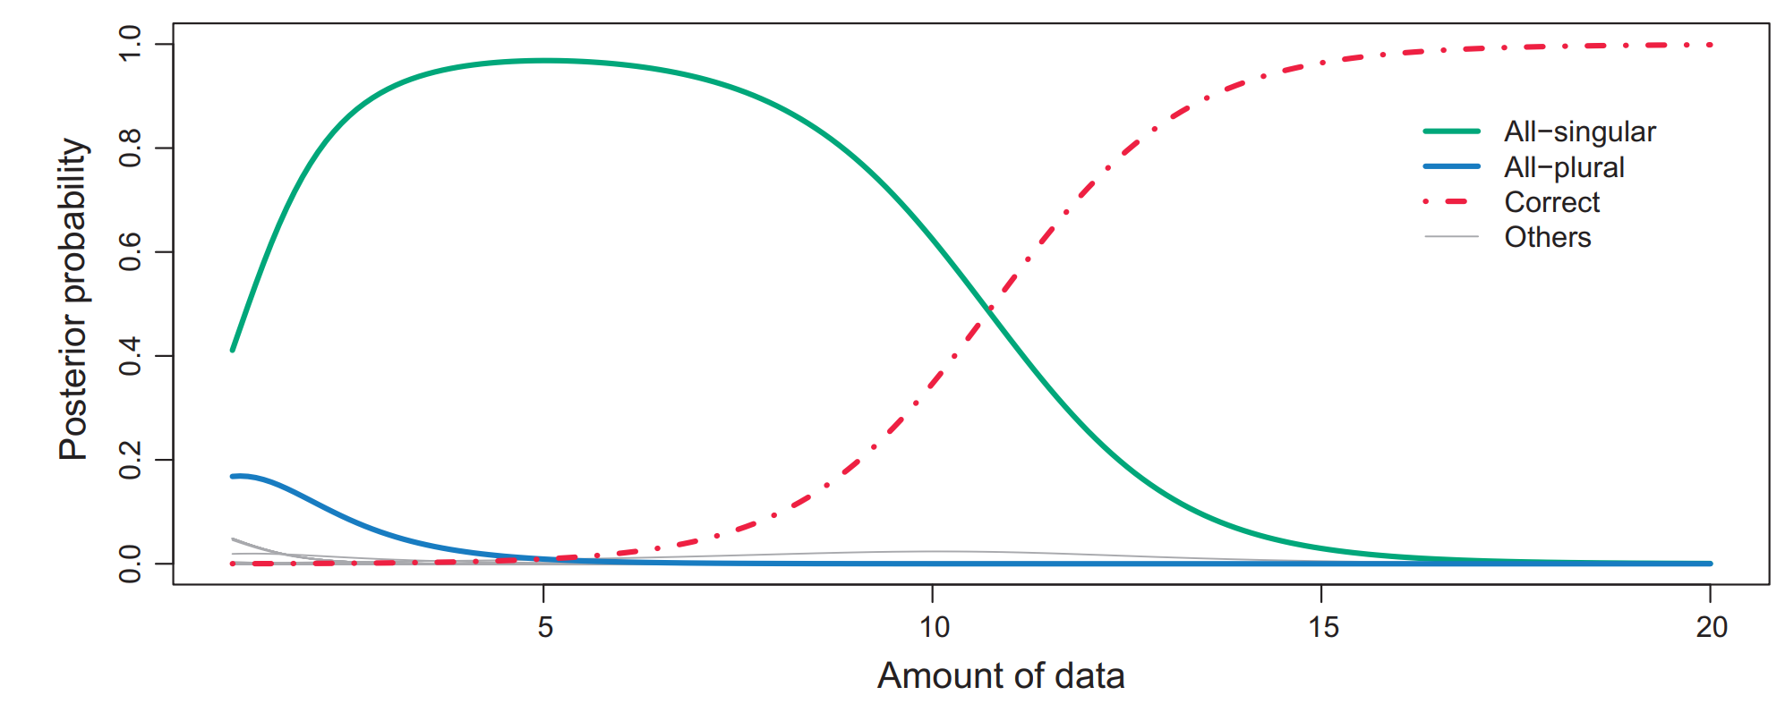
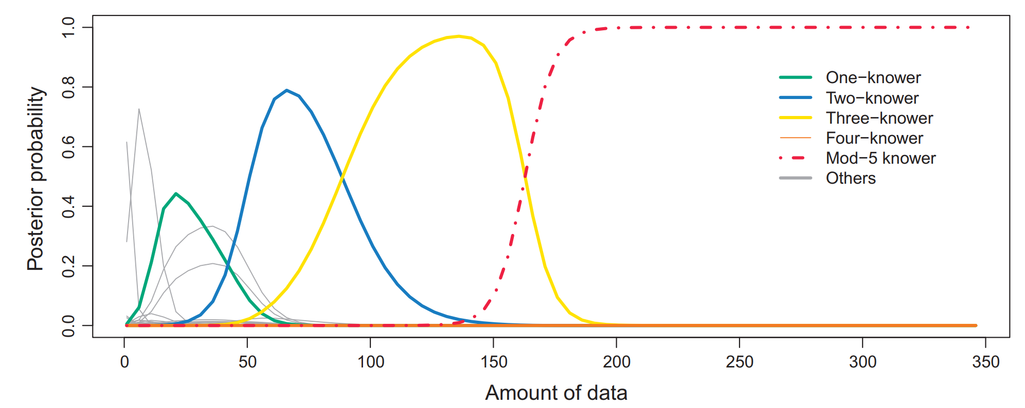
Learning Numerals with an LoT
The same LoT
on singular/plural morphology
And mod-n systems
(e.g. days of the week)

Slide 22
Visual concepts - Overlan et al (2017)

Slide 23
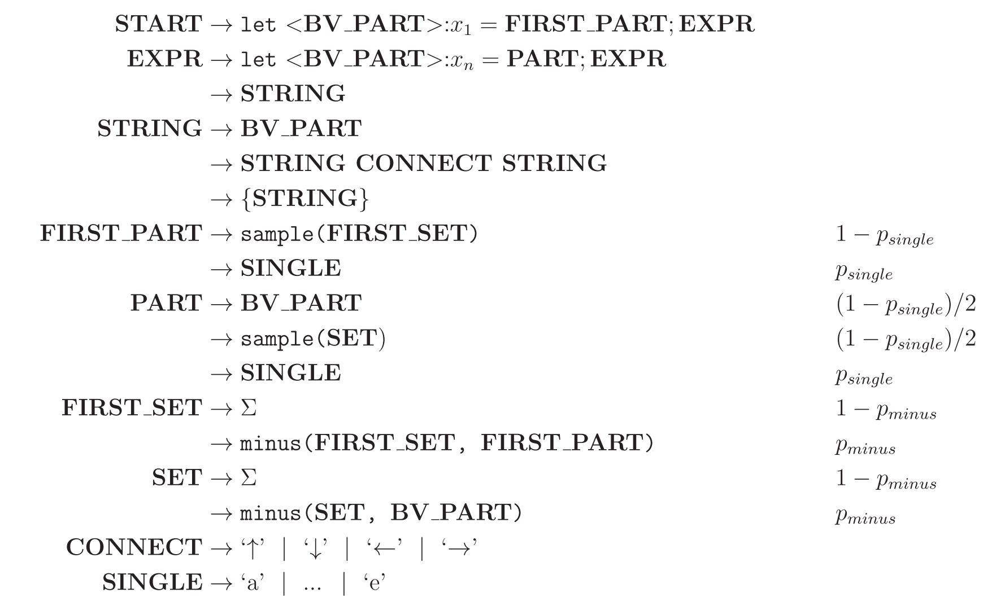
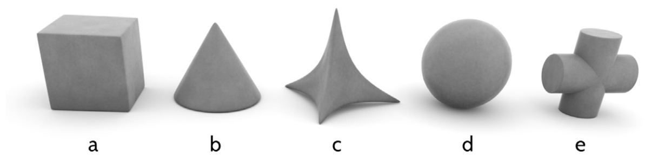
Visual Concept Learning in an LoT
Overlan et al (2017), Learning abstract visual concepts via probabilistic program induction in a Language of Thought
pLoT model of 3-d objects

Slide 24
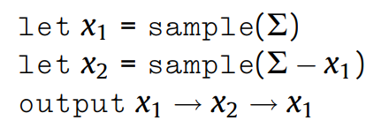
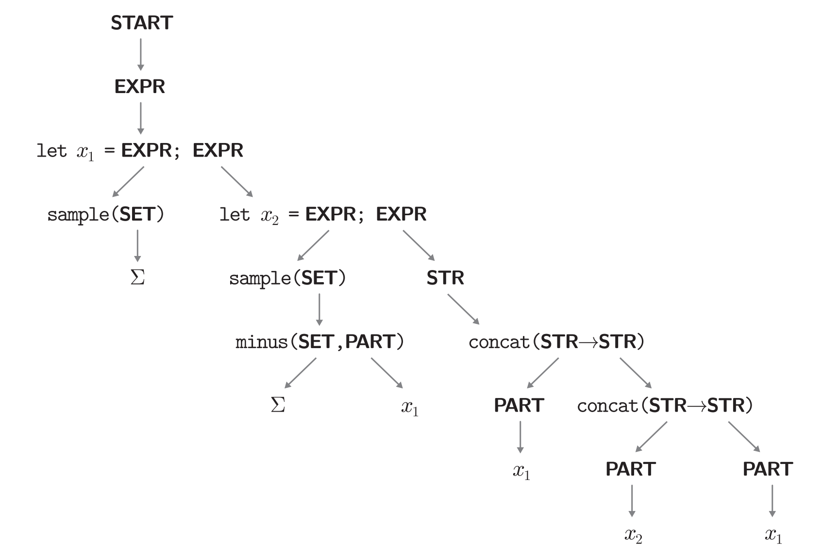
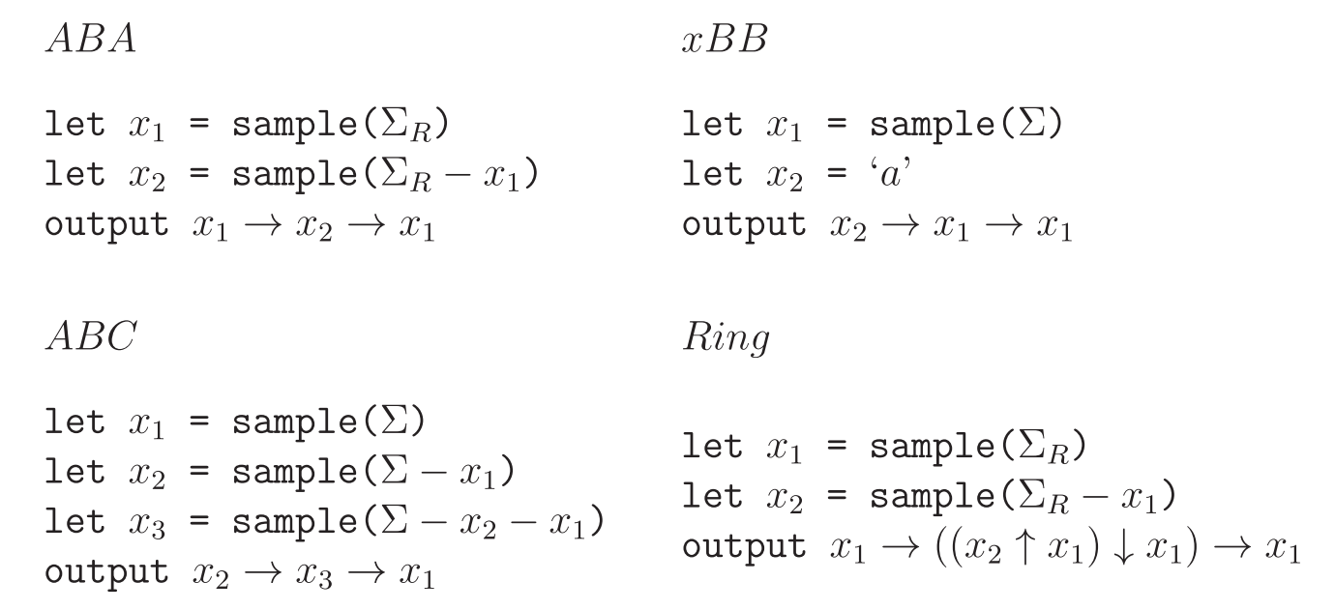
A derivation & some categories

Slide 25
Experimental design
120 participants
Instruction stage
Show all possible objects
Training stage
Show participants three
examples of a concept
Testing stage
Show 24 new items
Ask whether the concept applies

Slide 26
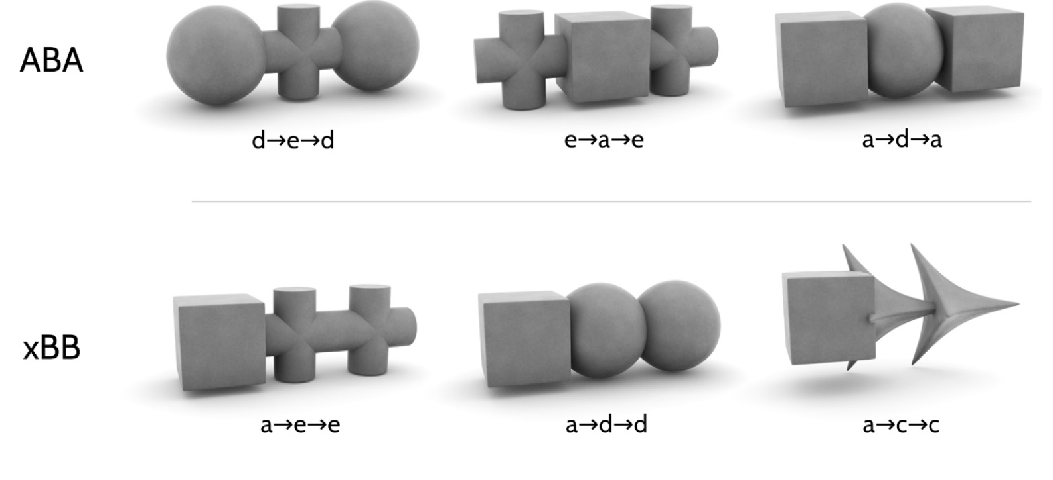
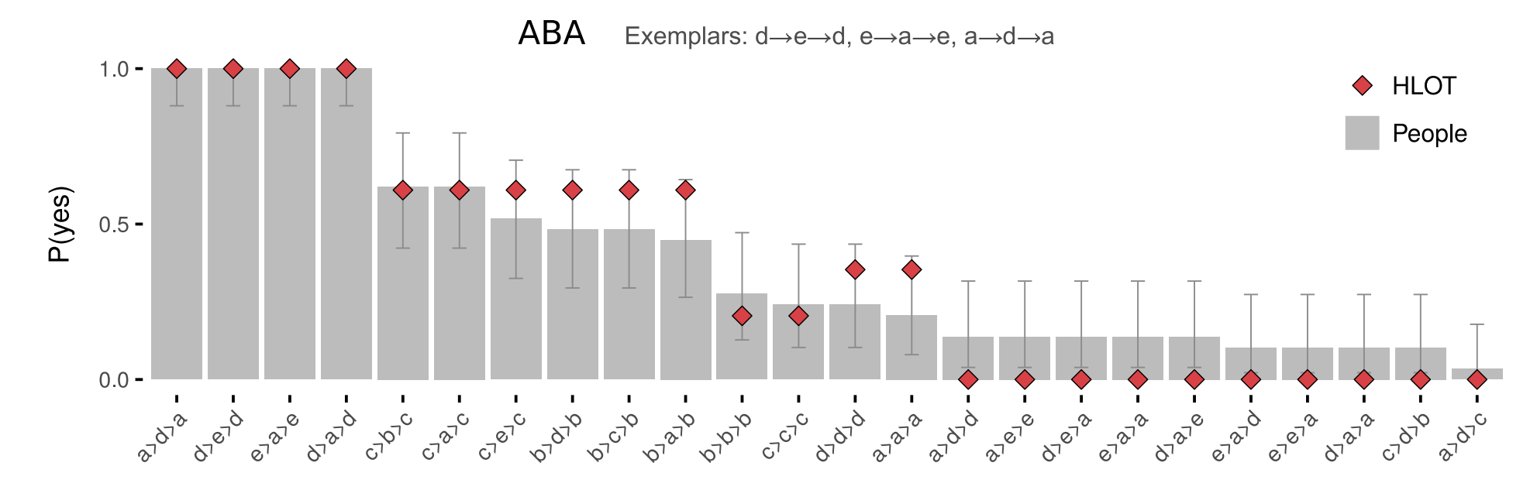
Experimental results

Slide 27
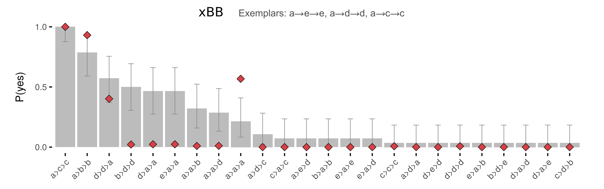
Experimental results

Slide 28
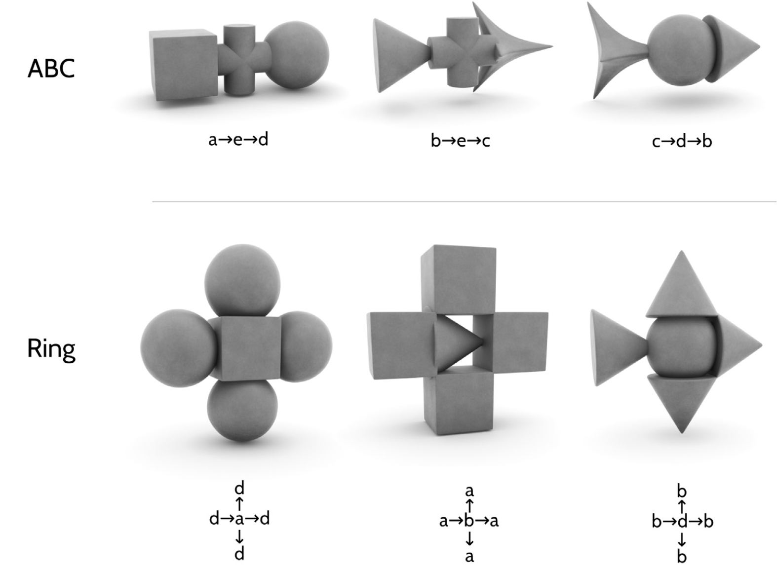
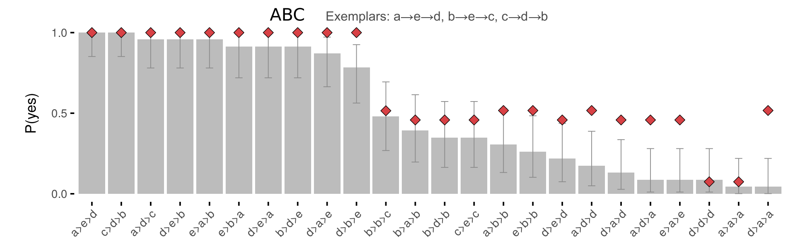
Experimental results

Slide 29
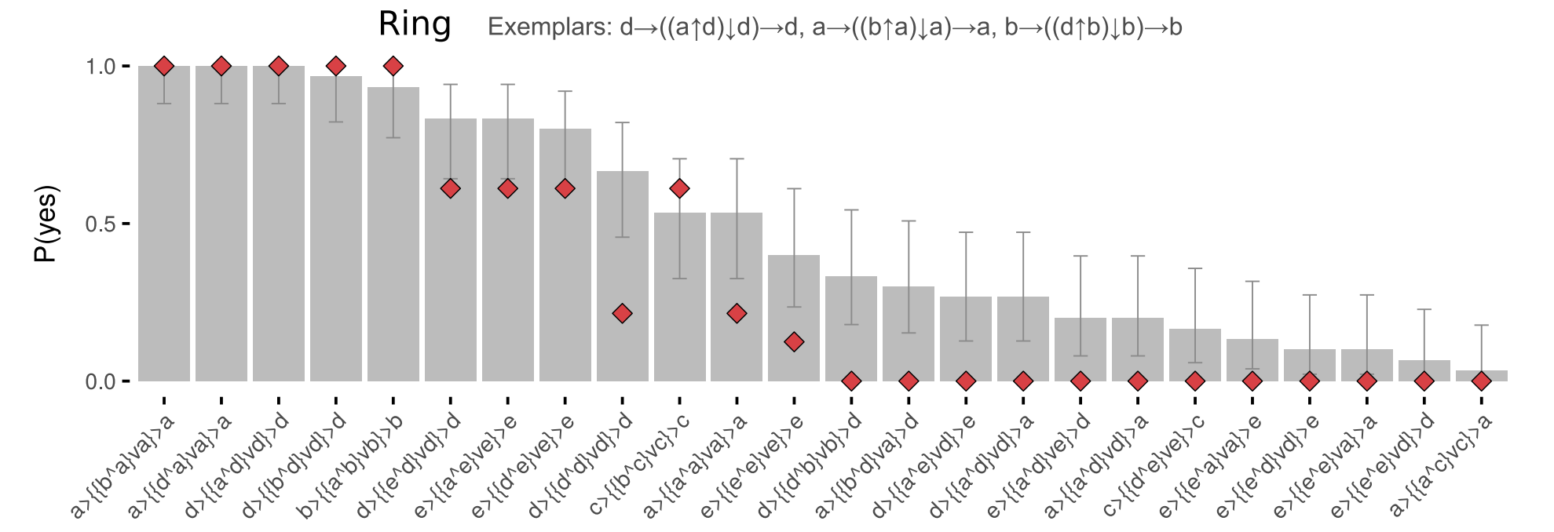
Experimental results

Slide 30
Sequences - Planton et al (2021)

Slide 31
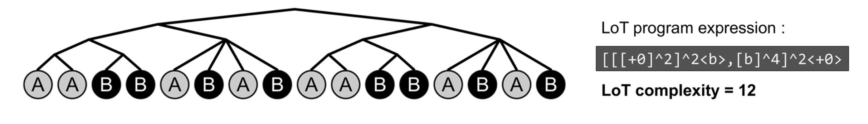
Sequence Learning in an LoT
Planton et al (2021), A theory of memory for binary sequences: Evidence for a mental compression algorithm in humans
New: Doesn’t use natural language.
pLoT model of how humans deal with binary sequences
E.g., {0,1}*
But e.g. it can be two pitches (auditory stimuli)

Slide 32
Sequence Learning in an LoT
Staying (“+0”)
Moving to the other item (here denoted ‘b’)
Repetition (“^n”, where n is any number),
Possibly with a variation in the starting point
Denoted by <x> where x is an elementary instruction, either +0 or b
Embedding of expressions is represented by…
brackets (“[. . ..]”)
concatenation by commas (“,”)

Slide 33
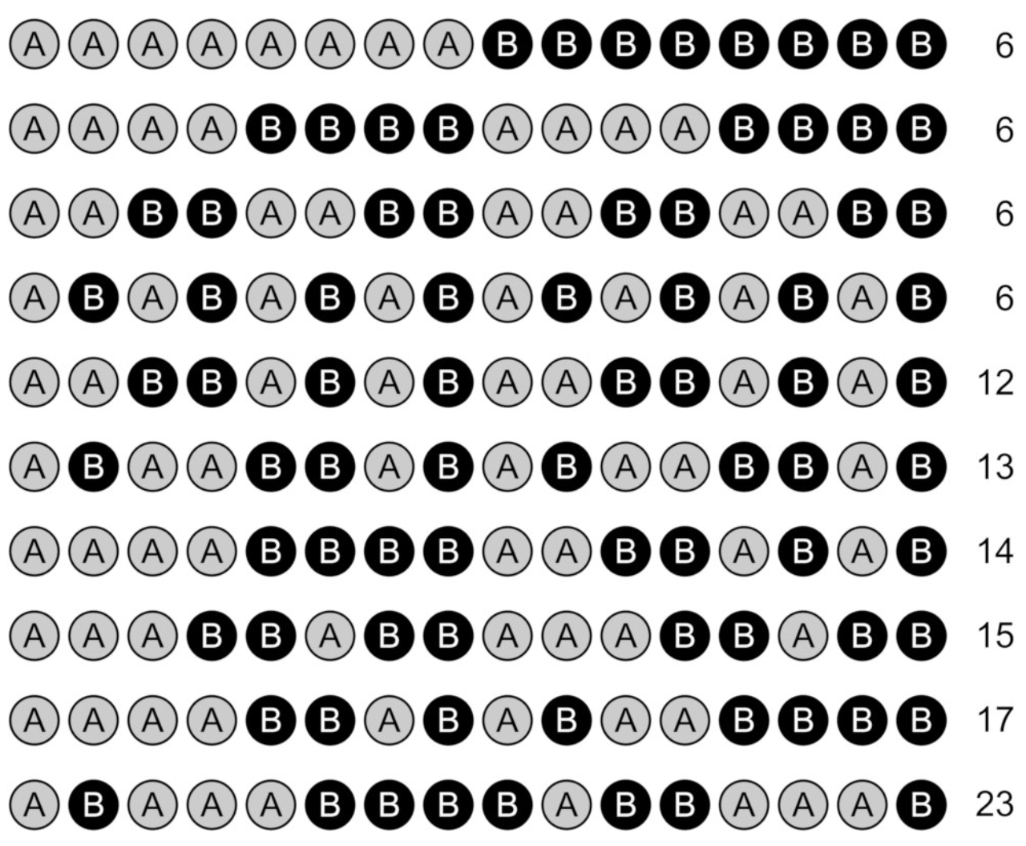
Which set has most complex sequences?

Slide 34
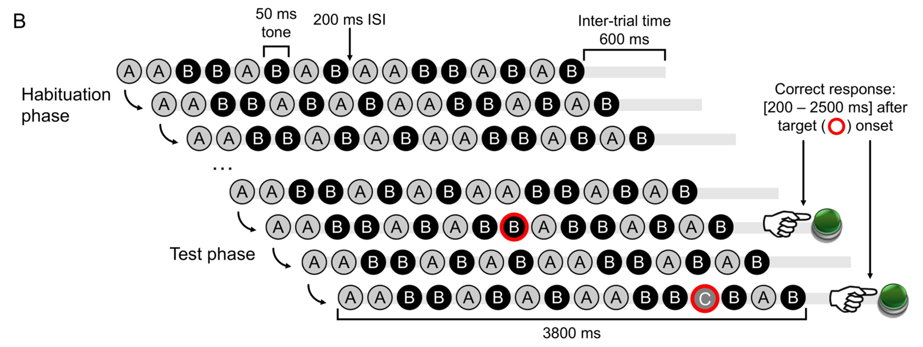
Sequence Learning in an LoT
‘Sequence violation’ experimental paradigm:
Empirical hypothesis: for equal sequence length, error rate and response time in violation detection increase with sequence complexity.

Slide 35
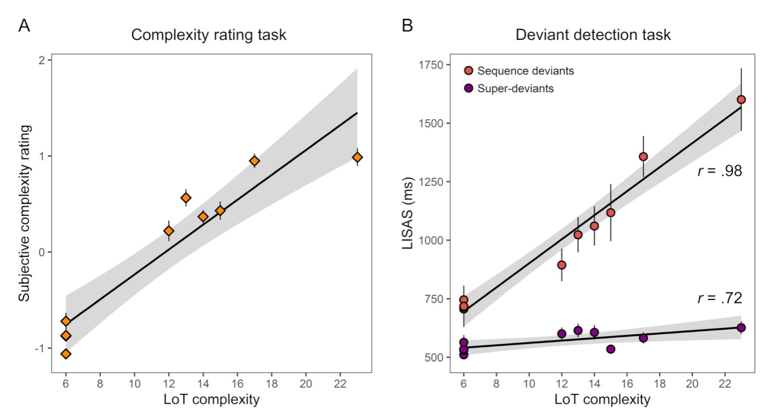
Sequence Learning in an LoT
First experiment results (16-items sequences)
Deviants identification
Sequence deviants
Switched note btw A and B
Superdeviant
A new note is introduced
Participants’ subjective complexity evaluations (left)
LISAS Linear Integrated Speed-Accuracy Score combines response times & error scores

Slide 36
Taking stock

Slide 37
The variety of applications of the pLoT
Linguistic
Non-linguistic
Kinship
Numerals
Visual concepts
Binary sequences

Slide 38
The variety of applications of the pLoT
Kinship
Numerals
Visual concepts
Binary sequences
Reflected categorization
Lower-level cognition
(Reaction times, errors)

Slide 39
The variety of applications of the pLoT
Familiar
New
Kinship
Numerals
Visual concepts
Binary sequences

Slide 40
The variety of applications of the pLoT
Typological
Kinship
Numerals
Visual concepts
Binary sequences
Acquisition
Experimental

Slide 41
The variety of applications of the pLoT
Abstract
Visual
Kinship
Numerals
Visual concepts
Binary sequences
Auditory

Slide 42
Intro & structure
Four examples today:
Kinship
Numerals
Visual concepts
Binary sequences
Part I | Introduction: On the very idea of an LoT
Part II | Technical background
Part III | Bayesian program induction (LOTlib3)
Part IV | Case studies
Part V | Summary & Future prospects

Slide 43
Discussion questions
What are other domains where we could apply this?
What other kinds of data could we explain?
Questions?

